Slide 1
Residence & Citizenship Planning for Americans
2026

Slide 2
About Henley & Partners

Slide 3

About the Firm
70+
Offices worldwide
25+
Years leading the sector
50+
Investment migration options
25,000+
Clients advised
15+
Government advisory mandates
USD 15 billion+
Foreign direct investment raised

Slide 4
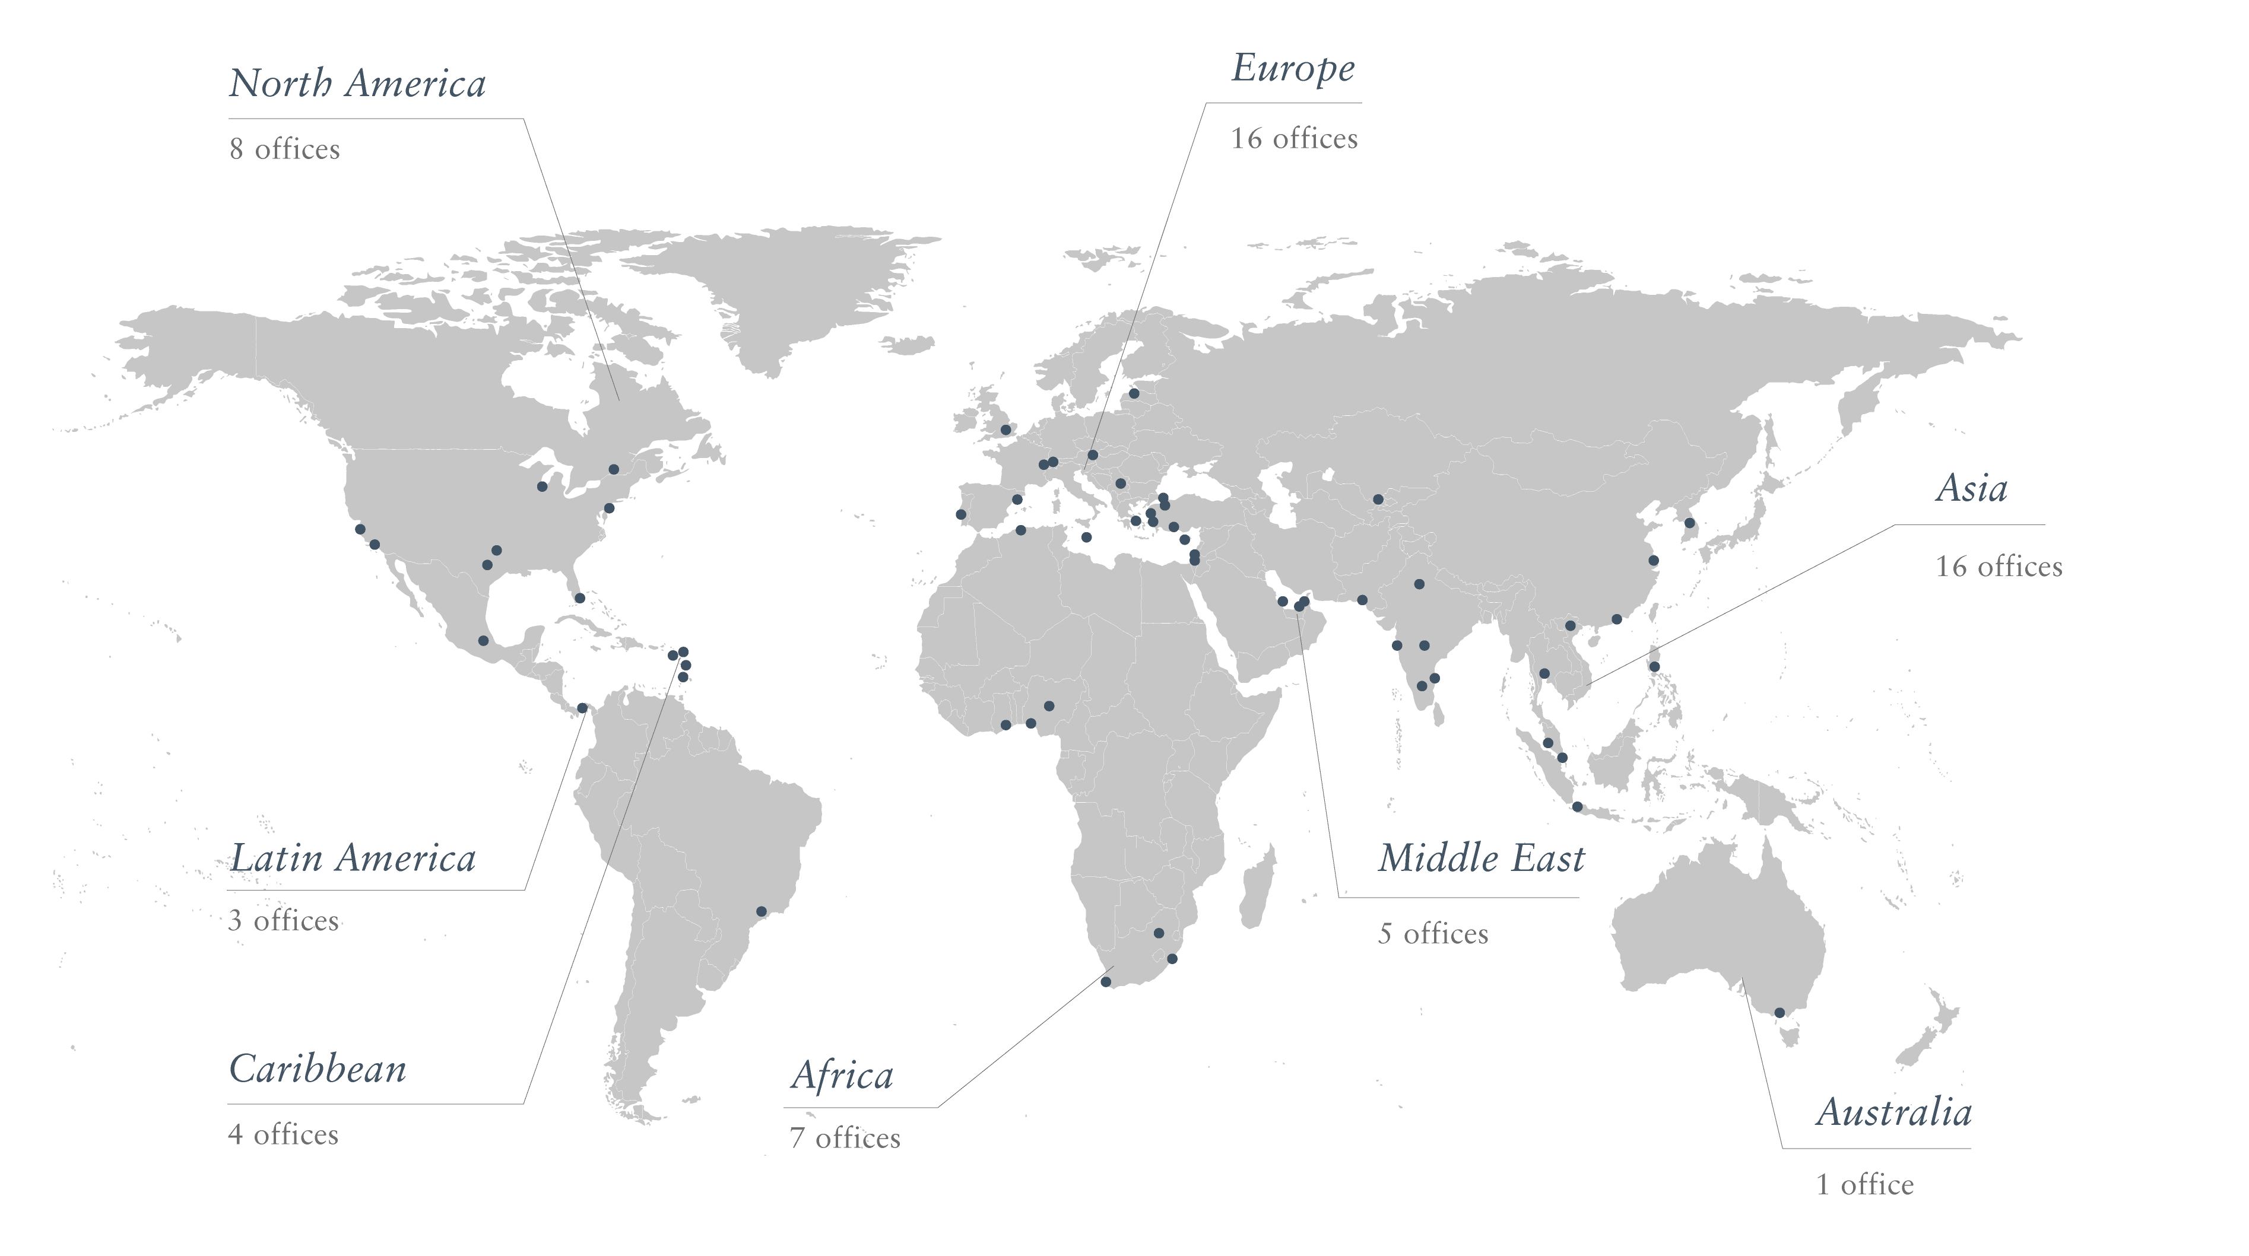
Global Presence — Over 70 Offices Worldwide

Slide 5
We Advise Private Clients and Governments
Private Client Services
Government Advisory Services
  Helping high-net-worth individuals and entrepreneurs to acquire one or more alternative residences and/or citizenships around the world
  Strategic consulting, design, set-up, operation, and promotion of residence and citizenship programs for countries worldwide
  Residence and citizenship planning
  Citizenship by Descent
  Citizenship by Merit
  Real Estate
  Education
  Concierge
  Residence and citizenship program design
  Program implementation
  Application processing and due diligence
  Global positioning and promotion
  Over 70 offices worldwide,
  leading the sector for over 25 years
  Raised over USD 15 billion in
  foreign direct investment

Slide 6
The Differences between Residence and Citizenship
Residence
May grant the right to live, work, travel, study and access to free public healthcare & education in a country
Usually comes with conditions or requirements
May give some travel rights
Can be withdrawn
Is likely to affect tax status
It may provide pathway to citizenship
Citizenship
Grants full rights, including the right to return to and reside in the country at any time and the right to vote
Can usually be passed on to future generations
Allows international travel
Affords protection from the state
Is lifelong and cannot be withdrawn (except in special circumstances)
Does not affect tax status (except in Eritrea, Kyrgyzstan, and the USA)

Slide 7
Reasons for Acquiring Alternative Residences / Citizenships
Global mobility
- A second passport can offer visa-free or easier travel to countries where a U.S. passport may require visas or face restrictions, plus flexibility during geopolitical uncertainty.
Plan B / Security / Insurance plan
- People want a backup option—somewhere stable to live, work, or relocate if there are political, economic, or social disruptions in the U.S.
Children's Education
- Residency or citizenship programs unlock access to better and more affordable education in top schools in Europe, the UK, and Australia & New Zealand.
Diversification of assets/Succession Planning
- Having a second residence or citizenship can make it easier to open bank accounts, invest internationally and operate businesses globally.

Slide 8

Most Popular Programs for US citizens
Caribbean:
Europe
Others
Non-Americans often come to the US through the EB5 program
Grenada | St. Kitts & Nevis
Greece | Portugal
Italy | Switzerland
Malta
Australia | Panama
Costa Rica | UAE
New Zealand

Slide 9
Most Popular Options for Americans

Slide 10
Europe

Slide 11
Portugal Golden Residence Permit Program
Overview
With its rich history, Portugal is considered one of the world’s most globalized nations and is ranked among the top 10 countries on the Global Peace Index. Its streamlined legislation creates an efficient process by which non-EU citizens may obtain a residence permit based on investment.
Key benefits
Visa-free travel in Europe’s Schengen Area
Eligibility to apply for a permanent residence after 5 years and citizenship after ten years as while keeping other citizenship(s)
Low physical presence requirement
Family reunification, including civil and same gender partner
Minimum contribution of EUR 250,000
Donation Option: EUR 250,000 EUR
Investment Fund Option: EUR 500,000
Henley Passport Index
Rank: Top 5
Score: Approximately 190 destinations

Slide 12

Malta Residence by Investment Program
Overview
Malta has risen to be one of Europe’s leading investment locations, driven by its reputation for stability, predictability, and security. The Malta Permanent Residence Program grants residence rights to foreign nationals seeking an alternative residence in Europe.
Key benefits
Residence in an EU country and visa-free access across Europe’s Schengen Area for 90 days out of a 180-day period
Right to reside indefinitely in Malta
Investment required only for first five years
No residence requirement
Family members included
A property purchase of EUR 375,000 or a lease of EUR 14,000 per annum for a minimum of five years
Henley Passport Index
Rank: 6th
Score: Approximately 186 destinations

Slide 13

Greece Residence by Investment Program
Overview
The Greece Golden Visa Program is considered one of the most affordable residence by investment programs that provide access to Europe. Successful applicants and their families are able to benefit from visa-free access to Europe’s Schengen Area.
Key benefits
Visa-free travel within Europe’s Schengen Area
No requirement to reside in Greece
Unlimited expiry date of residence permit
Opportunity to rent out the investment property
Residence applicable to the whole family (married spouse, children under 21 years old, and parents of the main applicant and spouse)
Eligibility to apply for citizenship after seven years of residence
Ability to hold shares and receive income from the dividends of a company registered in Greece (but not to be employed in Greece)
Minimum investment from EUR 250,000
Henley Passport Index
Rank: 5th
Score: Approximately 186 destinations

Slide 14

Italy Residence by Investment Program
Overview
As a globally recognized tourist destination with major cities including Milan, Rome, and Venice, Italy offers investors access to a strong, well-connected EU market. Italian residents enjoy high standards of living, education, and healthcare, and a unique quality of life.
Key benefits
The right to live, work, and study in Italy
Visa-free travel across Europe’s Schengen Area
The right to apply for Italian citizenship after 10 years of residence
Residence in a country with a rich culture, attractive industries, and major global cities
Minimum investment from EUR 250,000 to EUR 2 million
EUR 250,000 in Italian Startup
EUR 500,000 Public Italian Shares
Henley Passport Index
Rank: Top 5
Score: Approximately 190 destinations

Slide 15
Middle East

Slide 16

The United Arab Emirates Residence by Investment Program
Overview
The UAE is one of the most attractive business destinations worldwide. UAE Residence by Investment is aimed at providing long-term residence to foreign investors, entrepreneurs, and talented individuals including specialists, students, and researchers who make a significant investment to the country.
Key benefits
Gateway to Africa and the Middle East, Asia, and Europe due to the country’s strategic geographic positioning
Safe, secure environment
High standard of services and good quality of life
Excellent schools that cater for international students
Favorable tax regime for investors — with no personal income, capital, net worth, or withholding tax and several double-tax treaties in place
Good value from real estate investments
Streamlined, efficient residence permit system
Member state of the United Nations, the Gulf Co-operation Council, and the Arab League
Minimum investment:
Real Estate Option:
USD 280,000
Henley Passport Index
Rank: 7th
Score: Approximately 174 destinations

Slide 17
Central America

Slide 18

Costa Rica Residence by Investment Program
Overview
The Costa Rica Residence by Investment Program offers excellent opportunities for investors seeking alternative residence, stability, and access to the Central American market.
Key benefits
Business-friendly environment
Favourable tax regime
Ability to include a spouse and children under the age of 18, as well as single, dependent adult children under 25
Eligibility to apply for citizenship after five years of residence for Central American, Ibero-American, and Spanish citizens, and after seven years for other nationalities
Minimum investment:
Real Estate: USD 150,000
Henley Passport Index
Rank: 28th
Score: Approximately 148 destinations

Slide 19

Panama Residence by Investment Program
Overview
Panama's residence by investment program, also known as the Panama red carpet visa, offers individuals the opportunity to gain residence by investing in this tropical country with an international banking center.
Key benefits
Business-friendly environment
Favourable tax regime
Ability to include a spouse and children under the age of 18, as well as single, dependent adult children under 25
Eligibility to apply for citizenship after five years of residence for Central American, Ibero-American, and Spanish citizens, and after seven years for other nationalities
Minimum investment:
Minimum investment of USD 100,000
Henley Passport Index
Rank: 25th
Score: Approximately 147 destinations

Slide 20
Caribbean

Slide 21

St. Kitts and Nevis Citizenship by Investment Program
Overview
St. Kitts and Nevis offers excellent opportunities for investors, including a range of real estate options and a uniquely and highly favourable taxation system.
Key benefits
Visa-free or visa-on-arrival travel to over 150 destinations
Citizenship by descent available for future generations
Ability to include a spouse & children as well as to add dependents after citizenship has been granted to the main applicant
Membership to the Commonwealth, entitling citizens to certain privileges in the UK and other Commonwealth countries
No minimum stay required
Minimum investment:
Real Estate: USD 325,000
Henley Passport Index
Rank: 30th
Score: Over 150 destinations

Slide 22

Grenada Citizenship by Investment Program
Overview
The Grenada Citizenship by Investment Program was launched in August 2013 when the Grenadian parliament passed the Citizenship by Investment Act, 2013. Henley & Partners was formally mandated in 2016 by the Government of Grenada to revitalize, enhance, and relaunch the program globally.
Key benefits
Visa-free or visa-on-arrival access to over 140 destinations, including China, Hong Kong, Singapore, the UK, and Europe’s Schengen Area
The only Caribbean citizenship by investment program that holds an E-2 Investor Visa Treaty with the USA, allowing citizens to be eligible to apply for a non-immigrant visa after being domiciled in Grenada for a continuous period of three years
Citizenship transferable to new spouses and future generations
The ability to include a spouse, children under 30, unmarried siblings aged 18 and over, parents, and grandparents of the main applicant and spouse
No restrictions on dual citizenship in Grenada
No minimum stay required
Minimum investment:
Real Estate: USD 270,000
Henley Passport Index
Rank: 25th
Score: Over 147 destinations

Slide 23
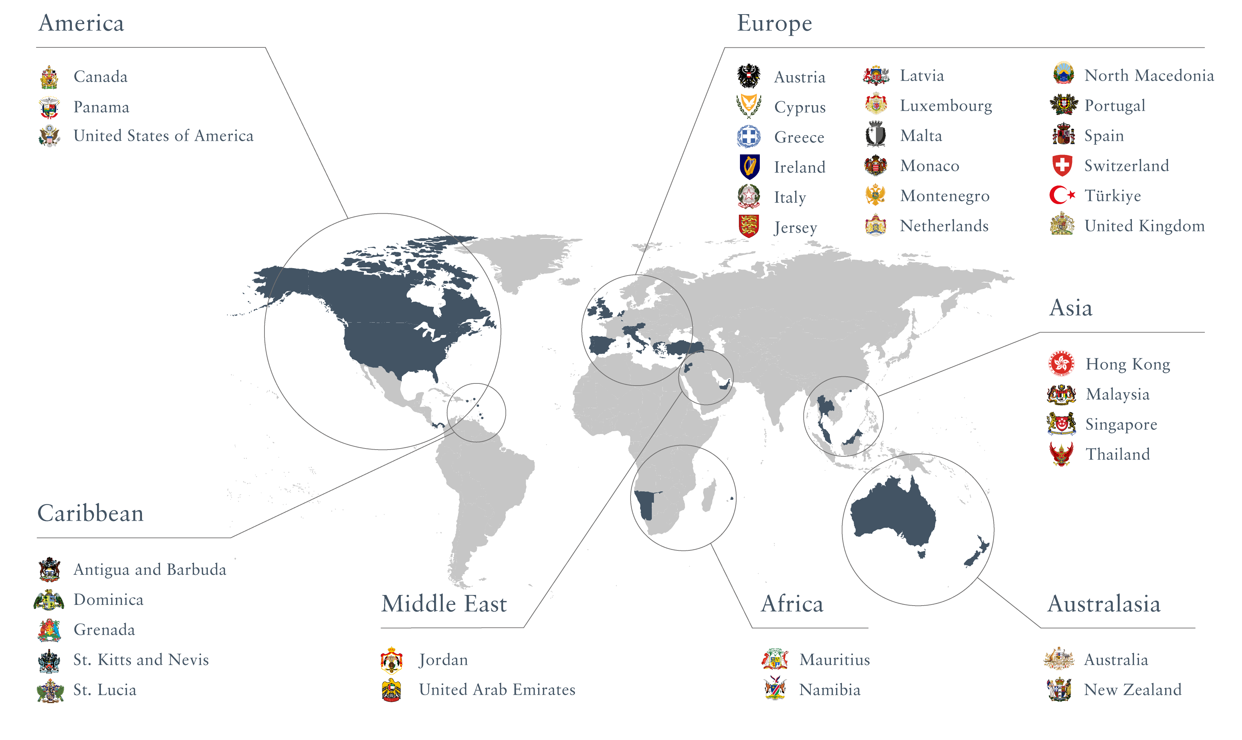
Leading Residence and Citizenship Programs

Slide 24





Contact Us
Agatha Osinska
Associate Director Private Clients
Henley & Partners USA Inc.
355 Alhambra Circle
Coral Gables, FL 33134,
USA
Mobile +1(561)3995607
agata.osinska@henleyglobal.com

